Slide 1

Predicting Default of Credit Card Clients
Abiola Ijaola
DATA606 Capstone
UMBC
Presentation 3

Slide 2
Presentation Approach
Project overview
Check for data unbalance
Exploratory data analysis
Model comparison and evaluations
Conclusions
What’s next

Slide 3
Recap of the project
Dataset
The dataset is collected from Department of Information Management, Chung Hua University, Taiwan and Department of Civil Engineering, Tamkang University, Taiwan.
The source URLs for the data is
https://archive.ics.uci.edu/ml/datasets/default+of+credit+card+clients.
I will be using open source software and code (Python & Jupiter Notebook)

Slide 4
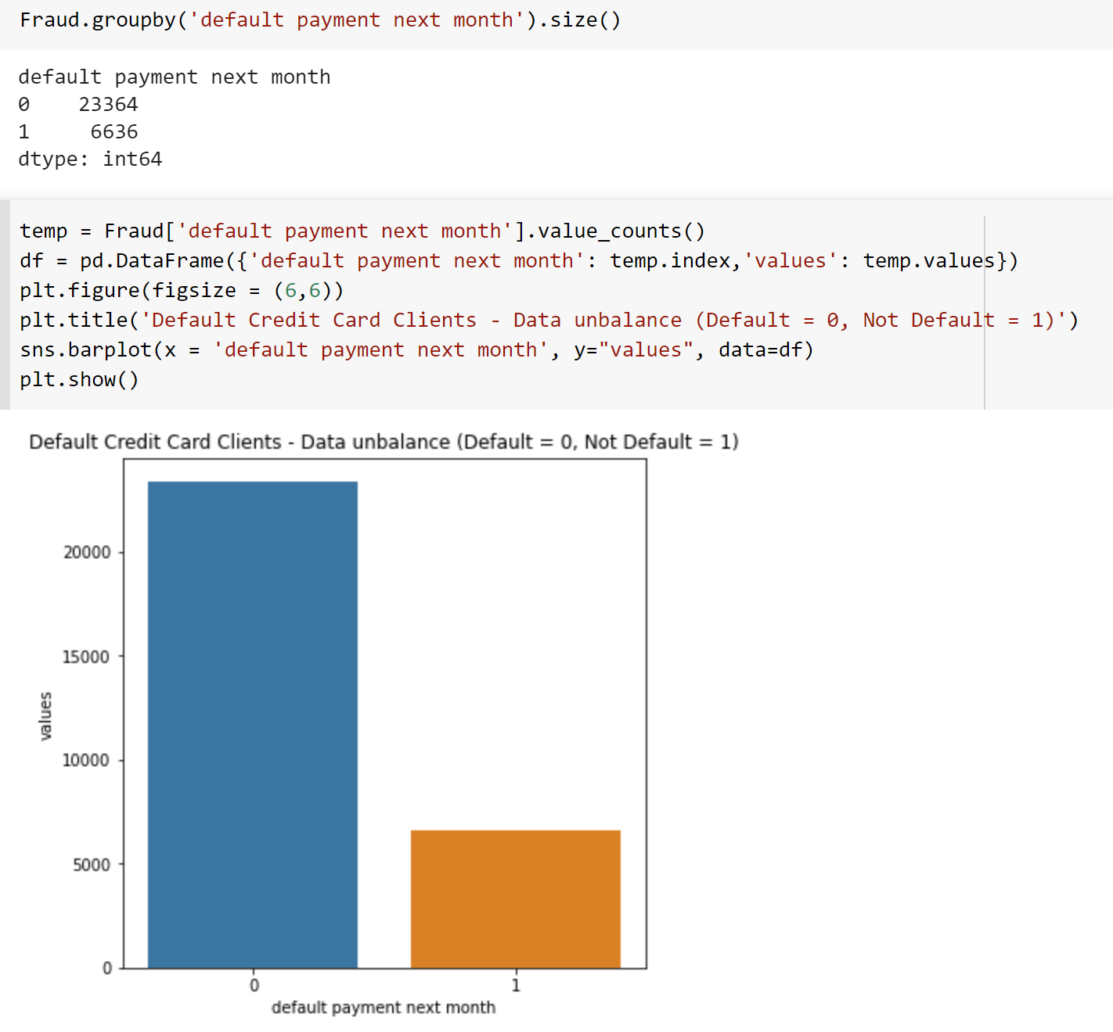
Check for Data Unbalance

Slide 5
Exploratory Data Analysis
The purpose of exploratory data analysis is to perform pattern discovery analysis on data using summary statistics and graphical representations

Slide 6
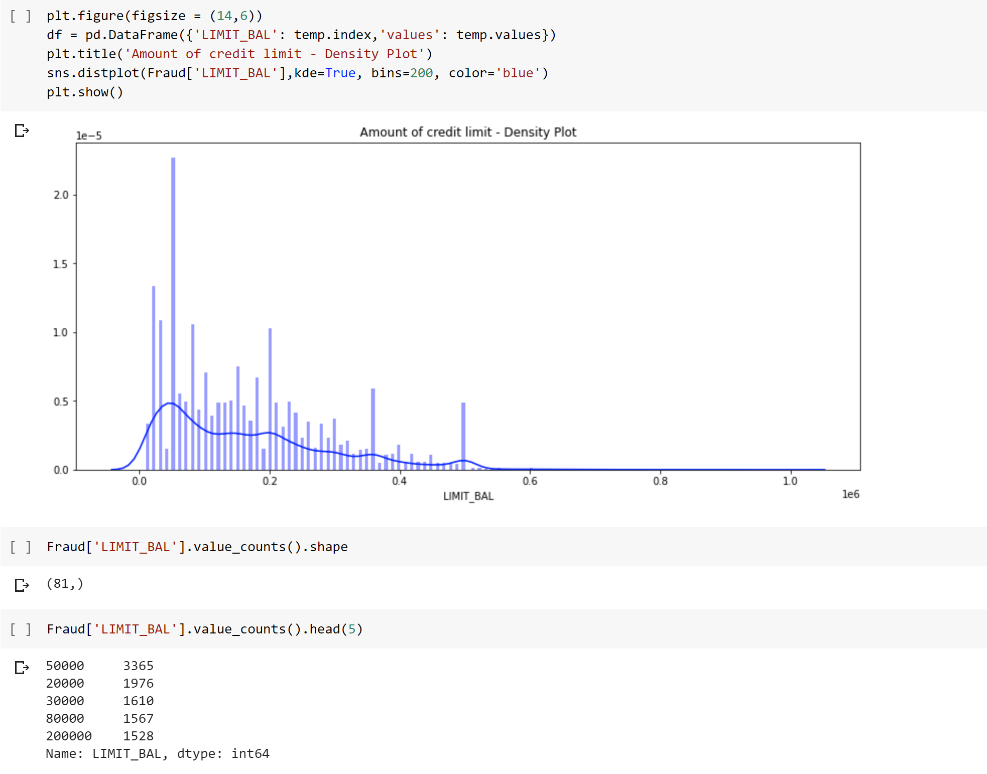
Amount of credit limit

Slide 7
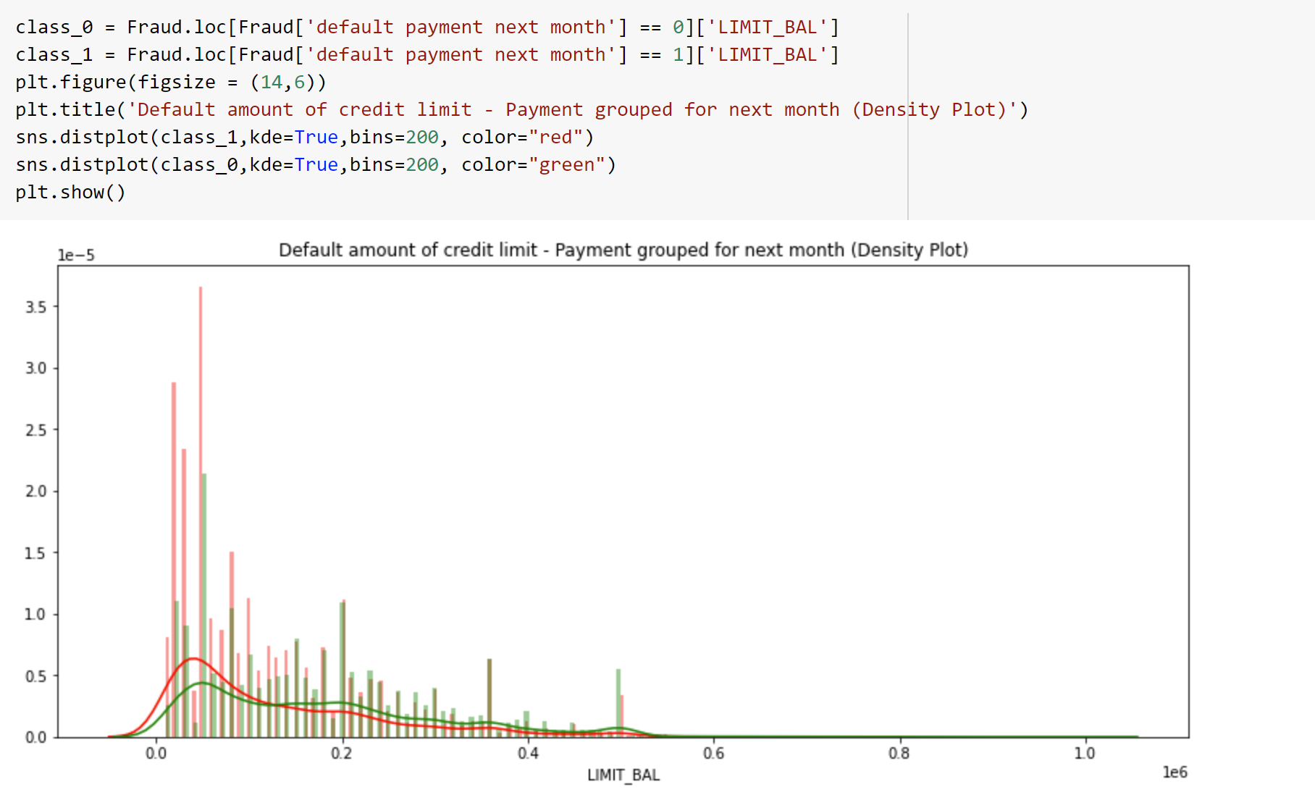
Amount of credit limit grouped by default payment next month

Slide 8
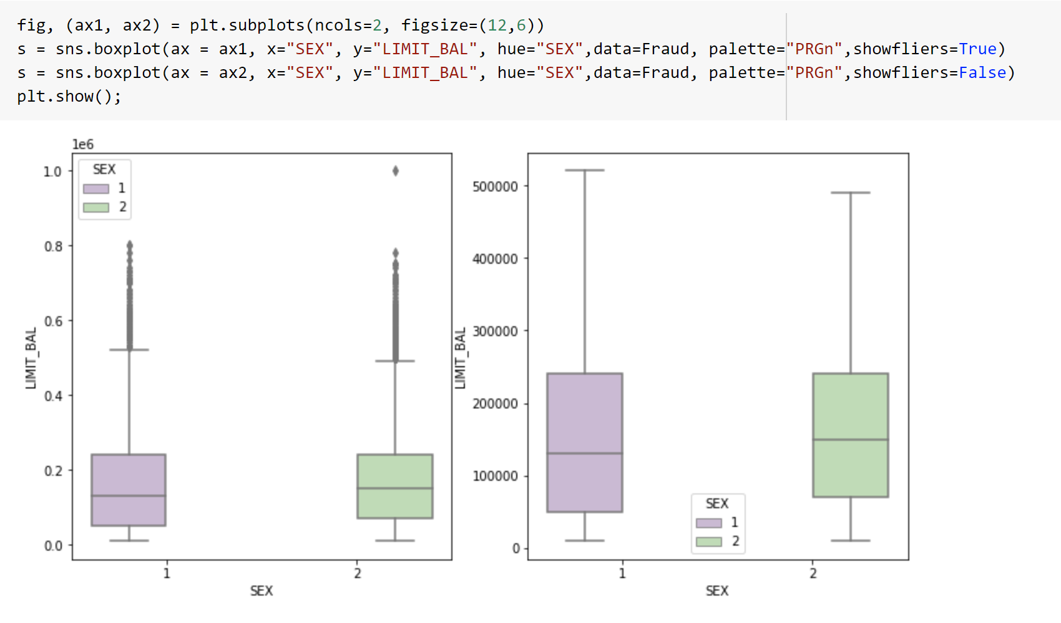
Credit limit distribution vs. sex

Slide 9
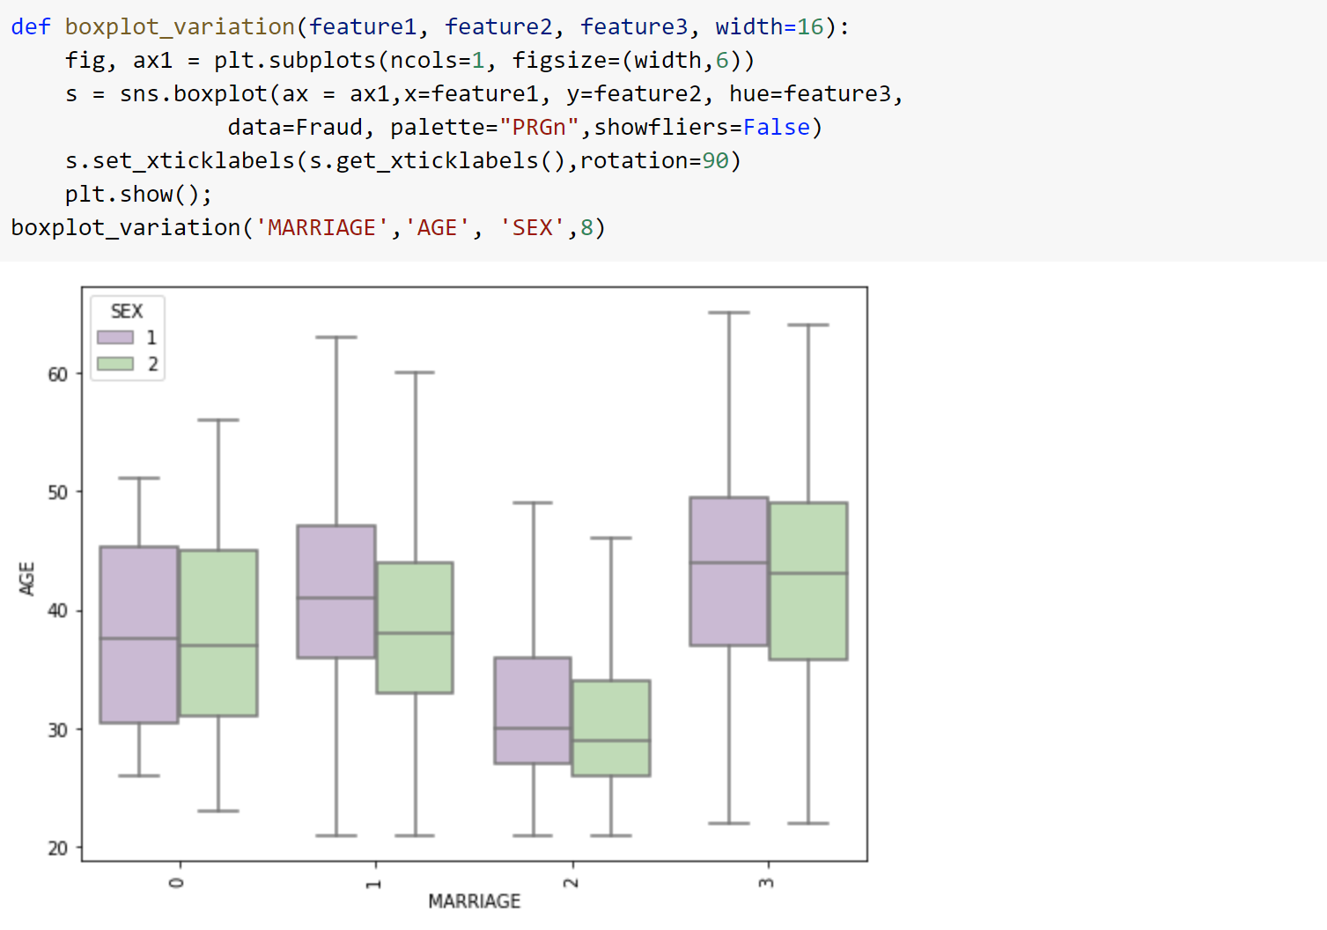
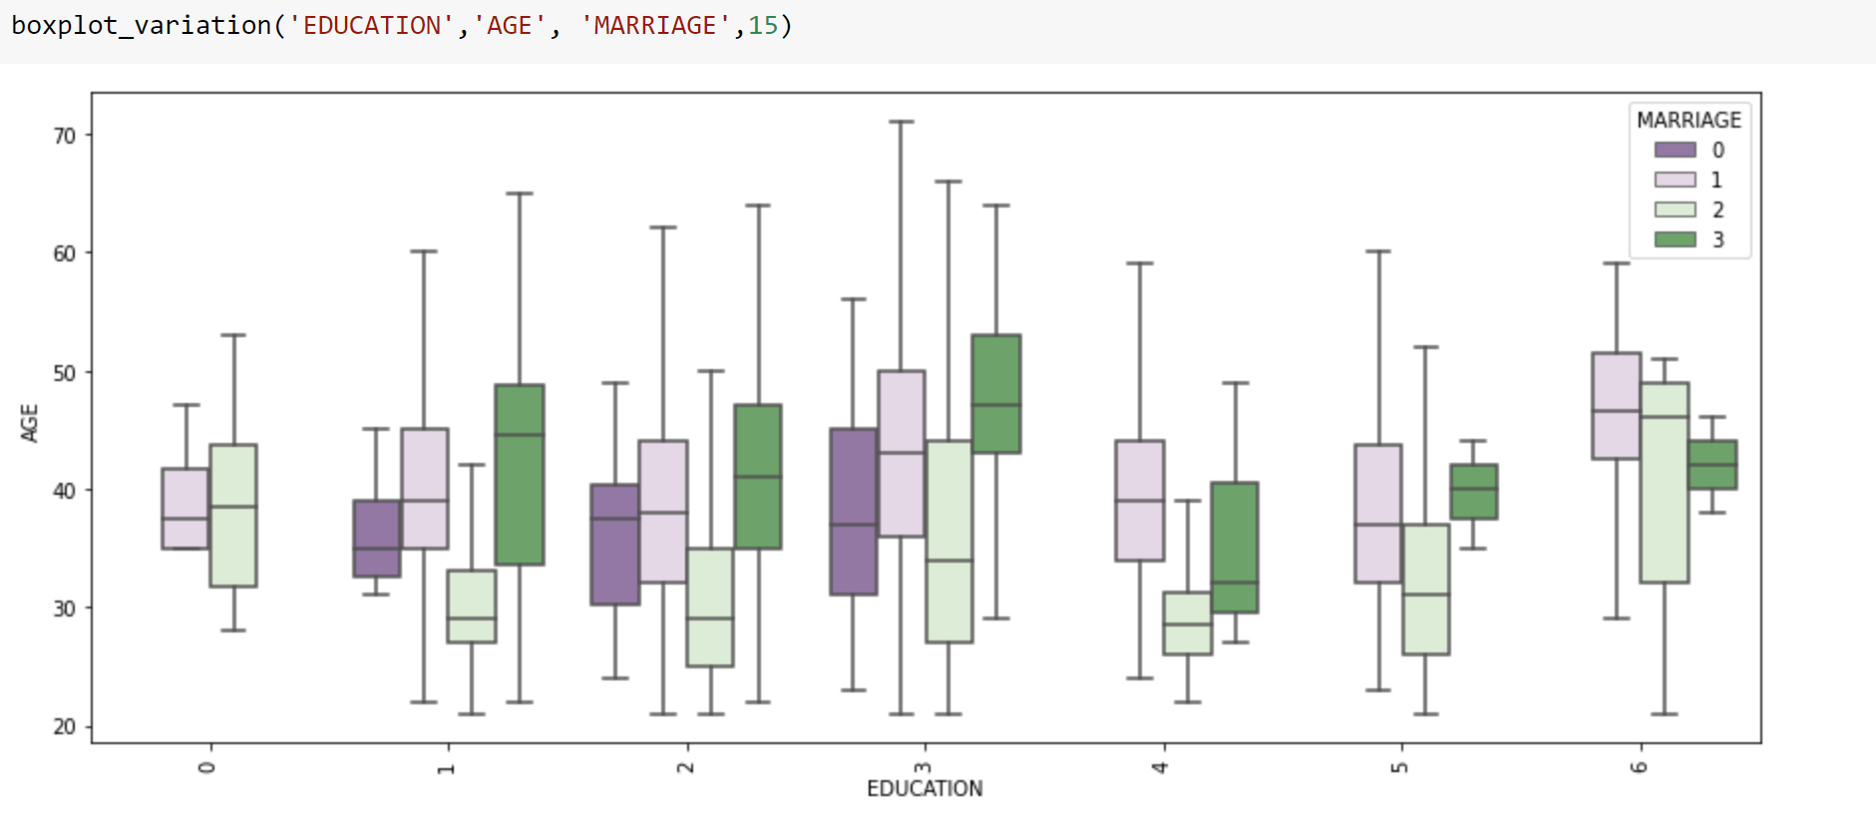
Sex, Education, Age and Marriage

Slide 10
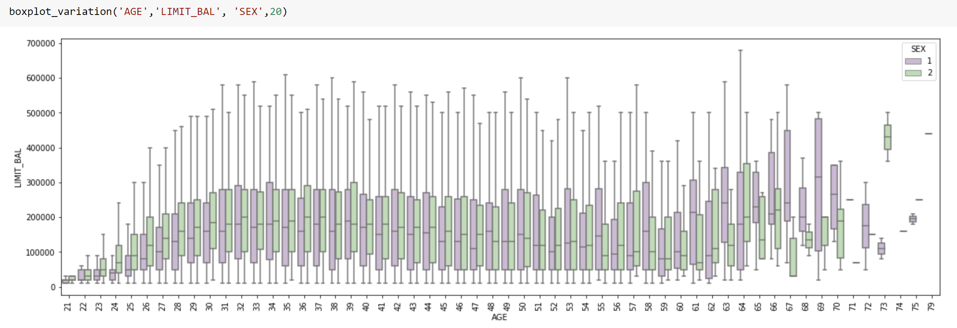
Sex , Age and Credit amount limit

Slide 11
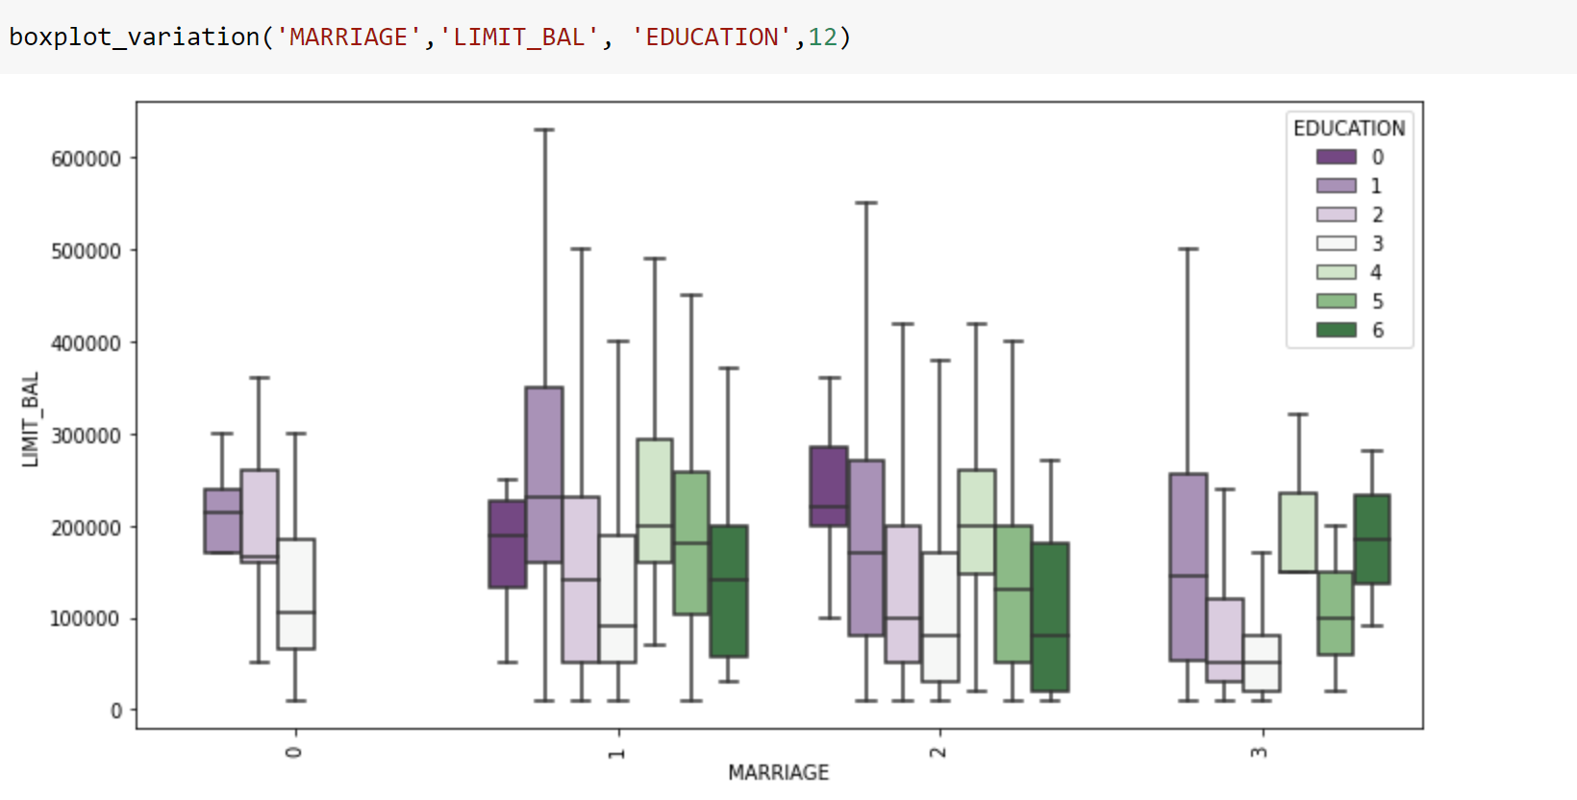
Credit amount limit, education and marriage status

Slide 12
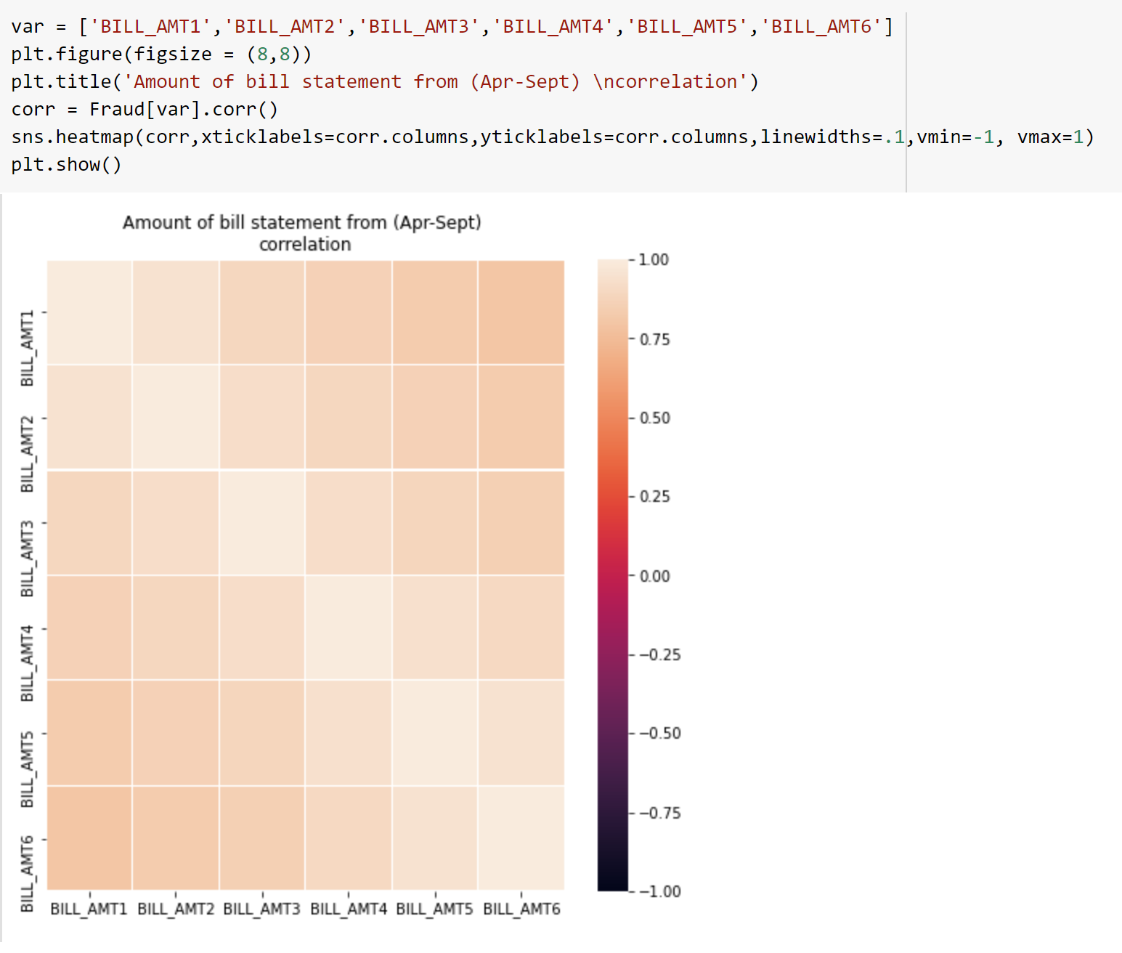
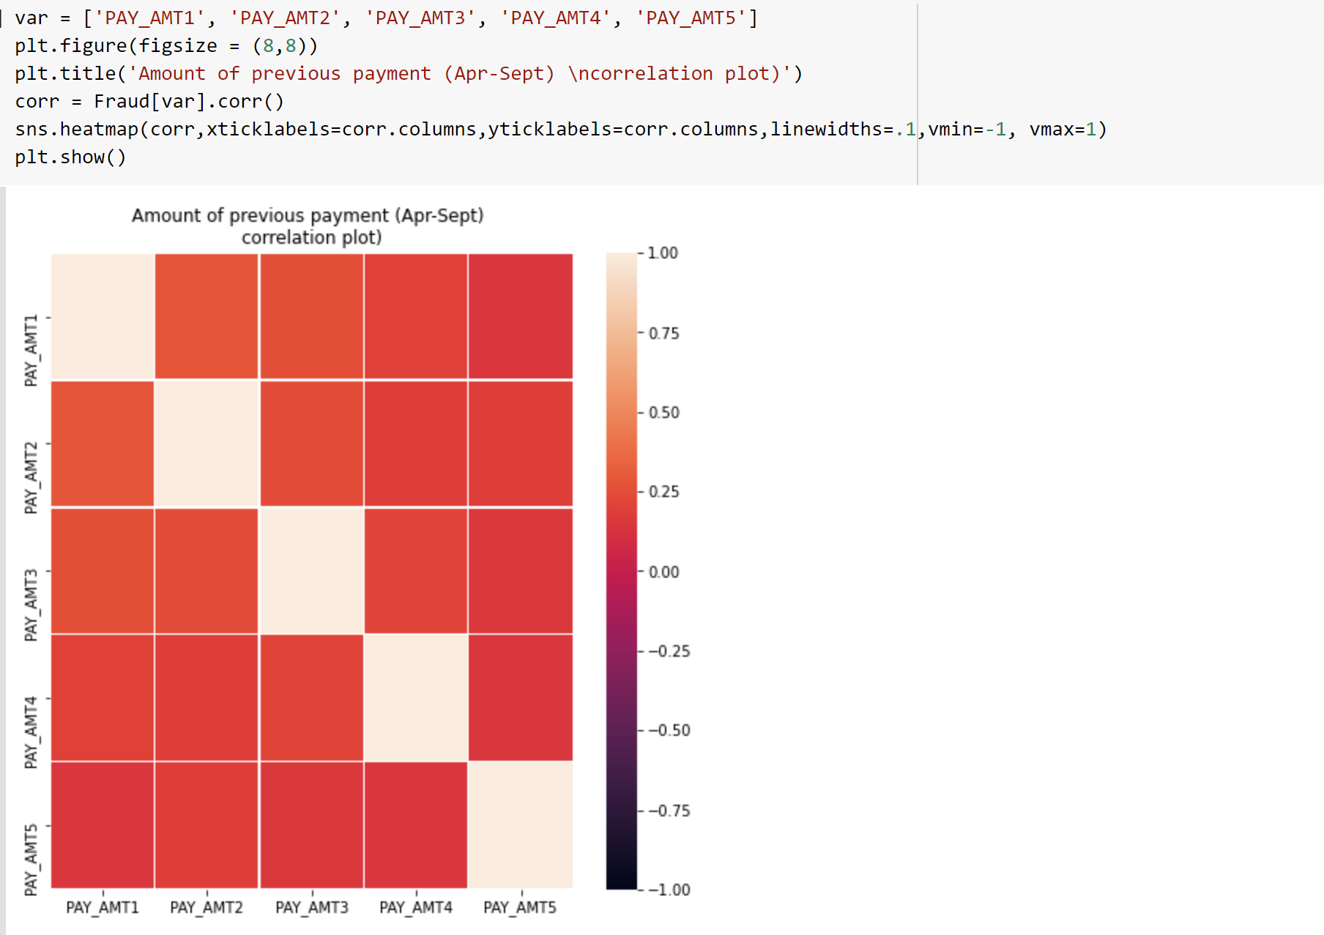
Features correlation

Slide 13
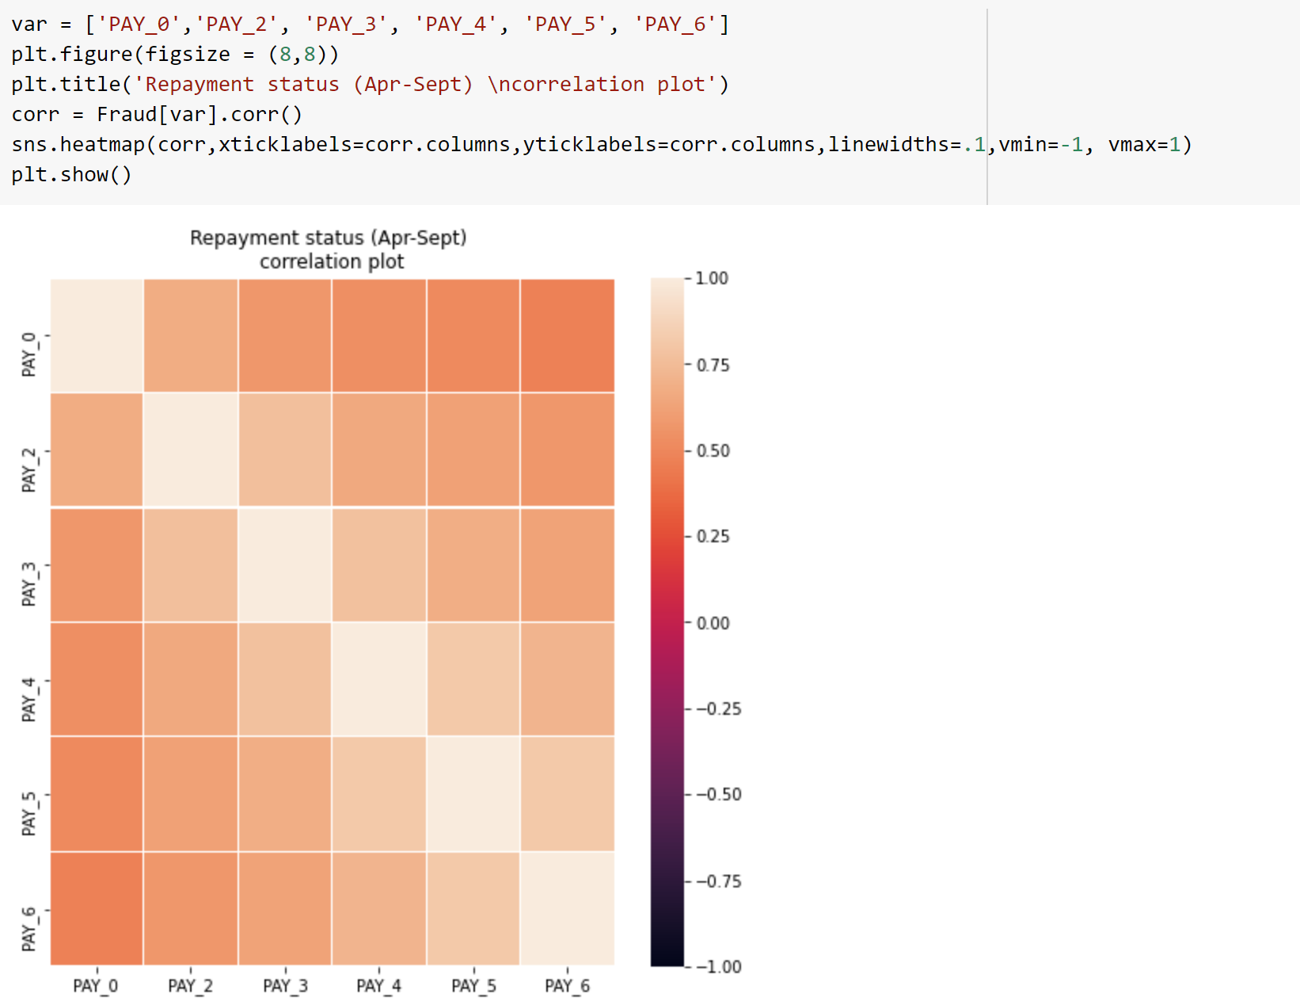
Continuation on Features correlation

Slide 14
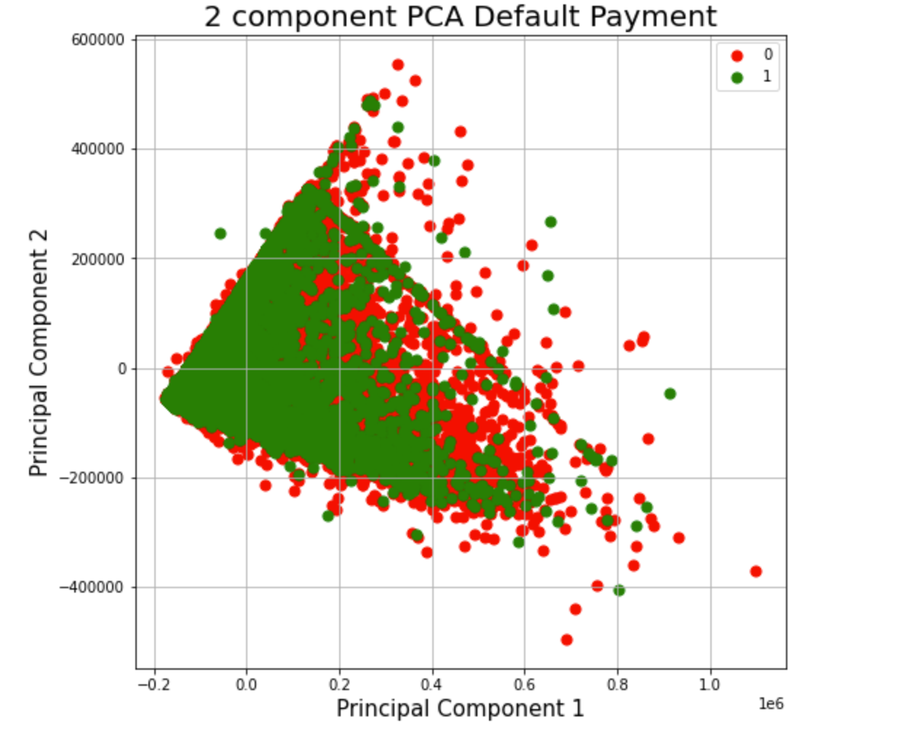
Principal Component Analysis (PCA)

Slide 15
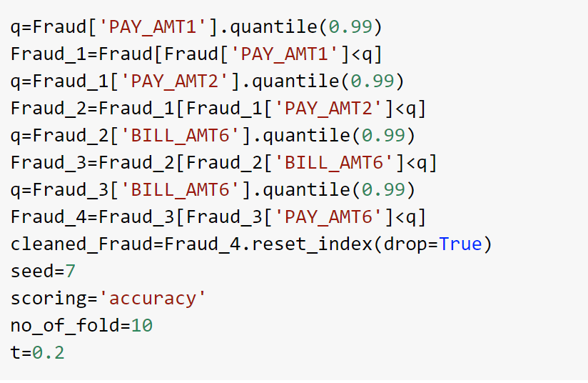
Outlier

Slide 16
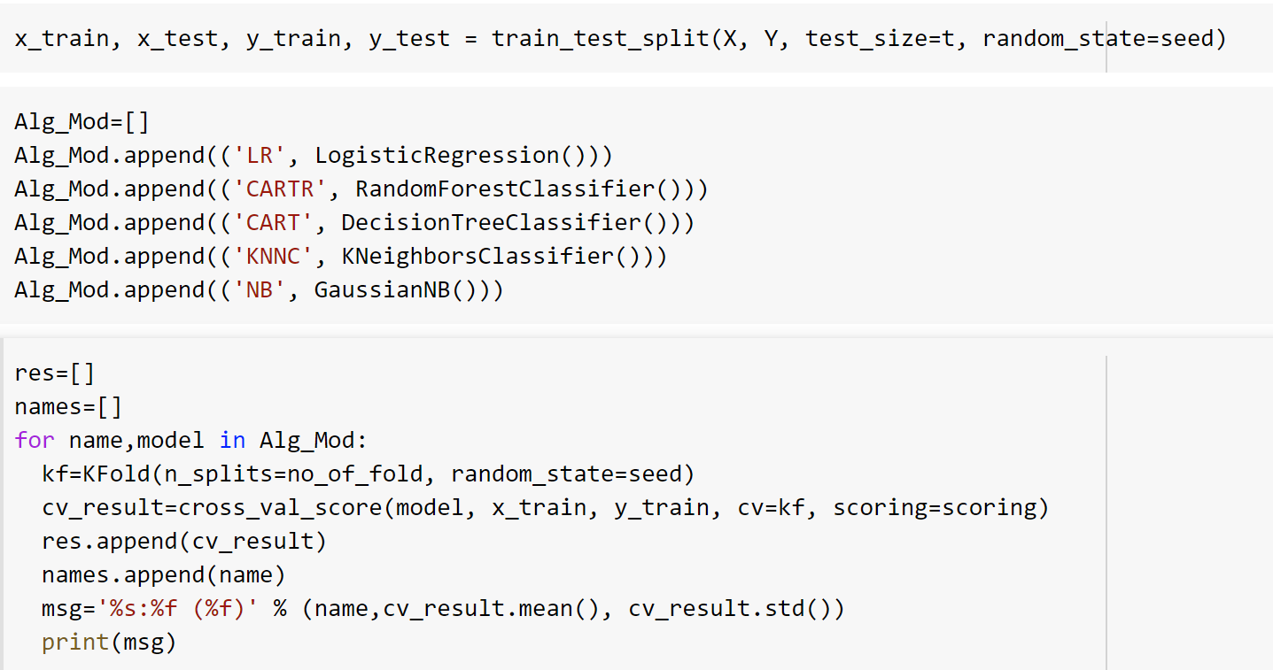
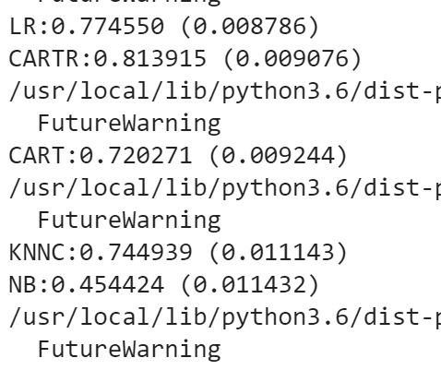
Model comparison and evaluation

Slide 17
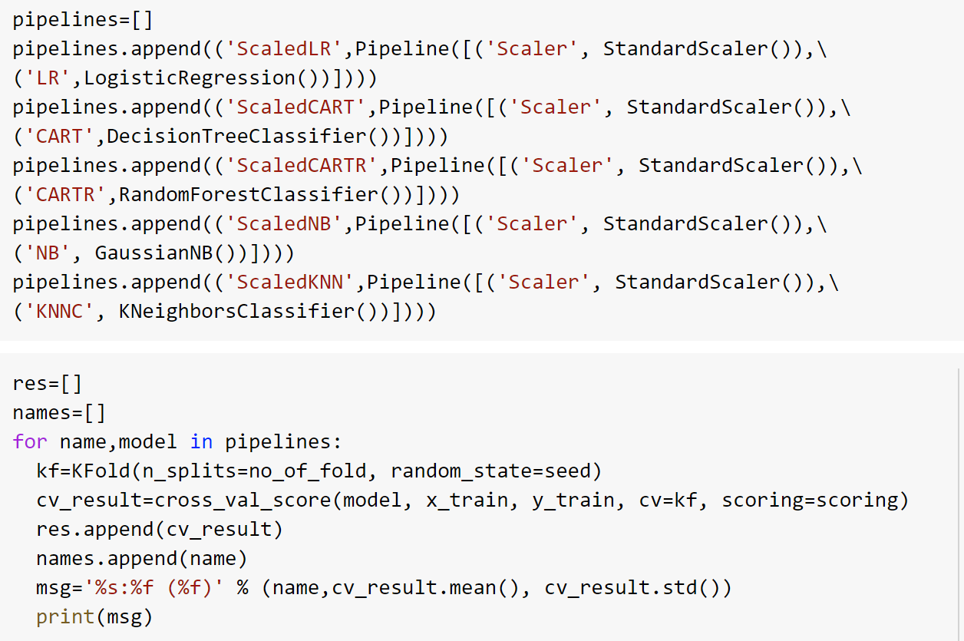
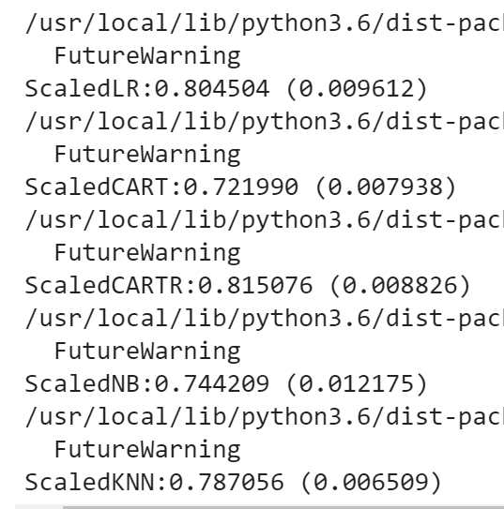
Continuation

Slide 18
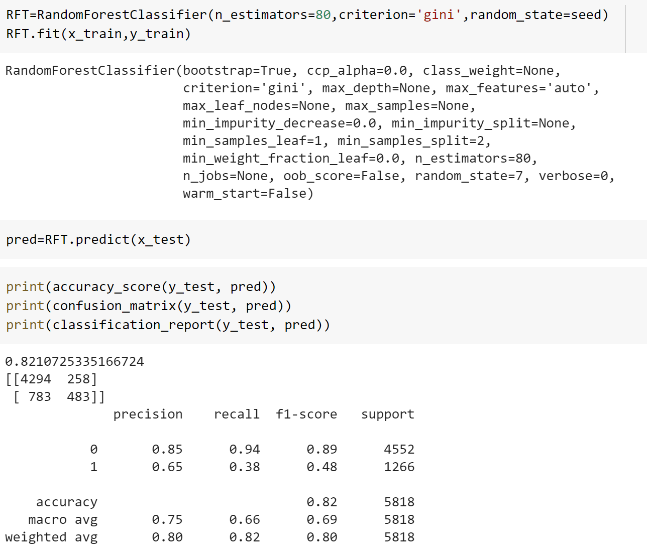
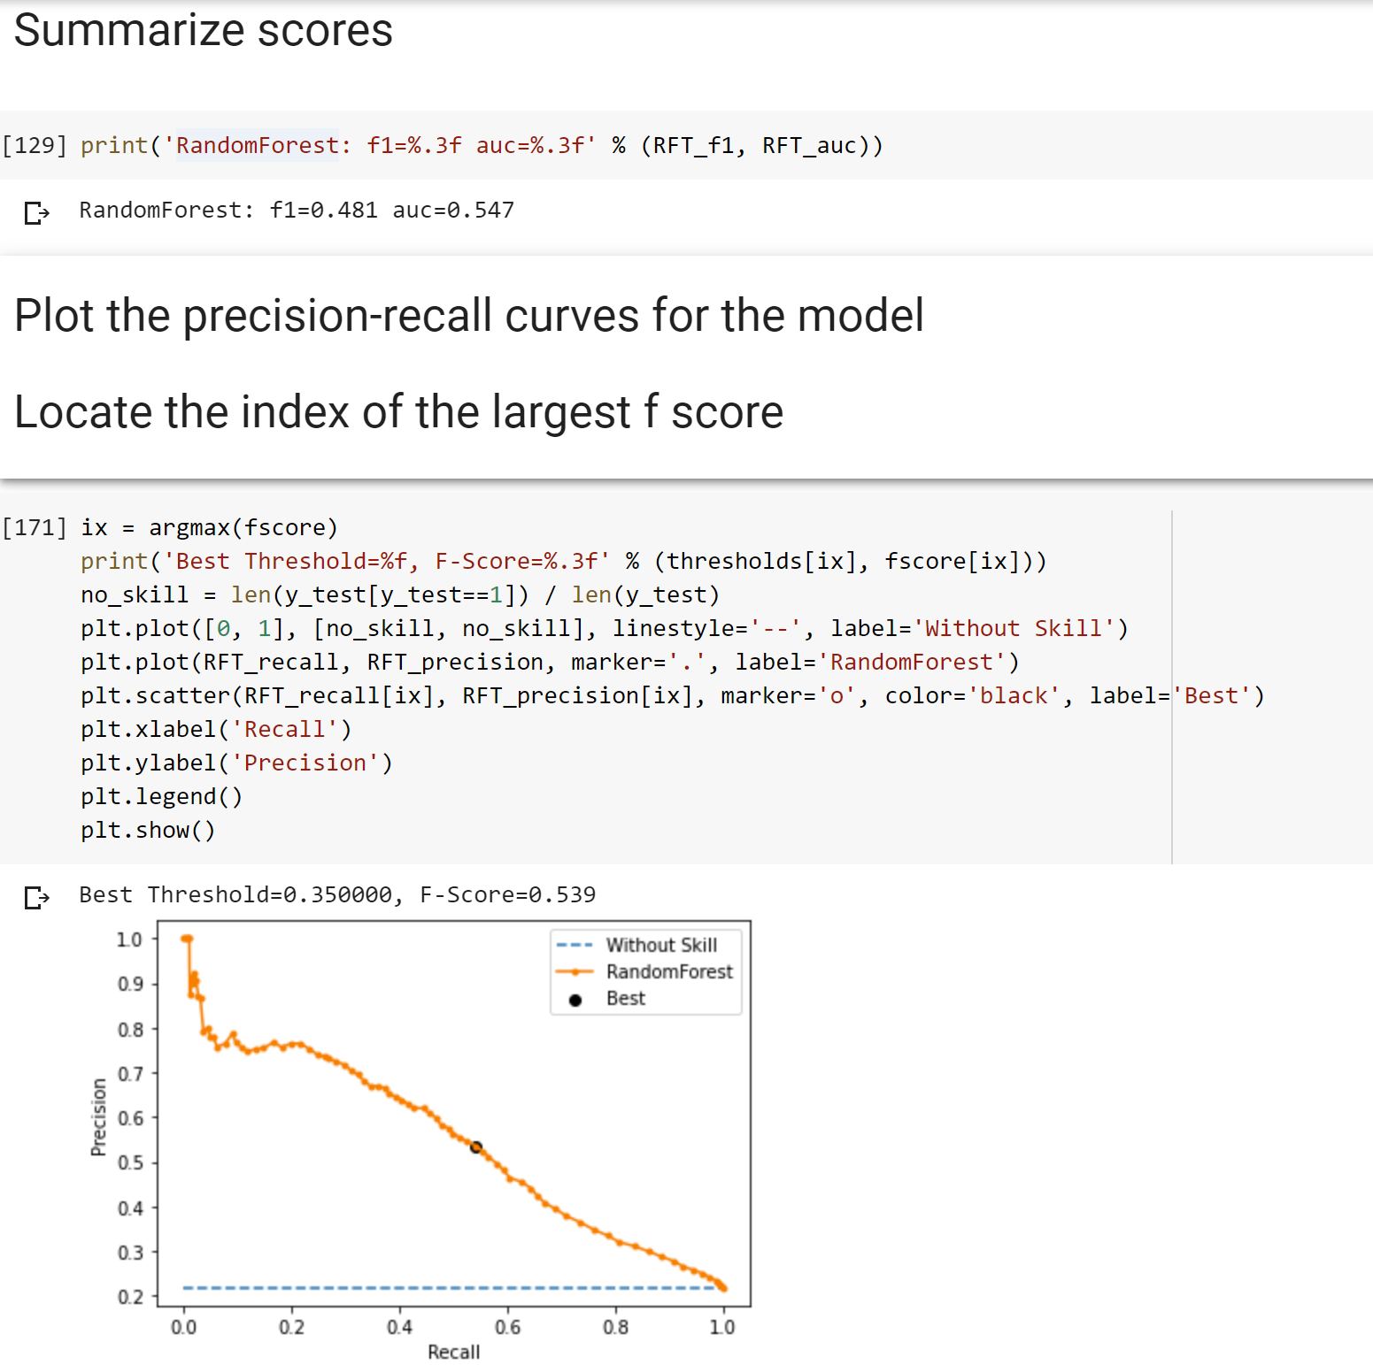
Final model - Random Forest

Slide 19
Next Steps
Finalize analysis
Re-run algorithms

Slide 20

Thank you
Notes:
That’s about it for now. I’ll be posting more videos as the project continues. Thank you for listening.

